Slide 1


Kotlin
By Adam Schaible and Krzysztof Rabka

Slide 2
Introduction
History
Where and why it all started?
People involved
Development goals
Language overview
Strengths and weaknesses

Slide 3



Founders of Kotlin
Introduction
Svetlana Isakova
Dimitry Jemerov
Andrey Breslav

Slide 4
Development Goals
Modern programming language
Concise, safe, pragmatic
Writing less code
Statically typed
Used everywhere where Java is used today
Including all existing Java libraries

Slide 5
Development Goals
Takes advantage of Java’s popularity
Main focus is on Android applications
Used also for iOS, Desktop applications
Scripting
Productivity improvements
Popular Android Apps written in Kotlin

Slide 6
General Language Overview
Hybrid
Functional
Object-Oriented
Imperative
Declarative
Procedural

Slide 7
General Language Overview
Paradigms
Written similar to Python or JavaScript or function blocks
No setters and getters
No need to specify types
Statically typed
Type inference
Overload-Resolution

Slide 8
General Language Overview
Syntax
Code is precise and shorter
Same basic rule like in Java
Easier single expression functions
Same logic for loops for all development applications
Semicolons are optional

Slide 9
Strengths and weaknesses – Comparing to Java
Java issues addressed in Kotlin
Null references
No raw types
Arrays are invariant
Proper function types
Use site variance without wildcards
No checked exceptions

Slide 10
Strengths and weaknesses – Comparing to Java
What Kotlin has that Java does not
Lambda expressions + inline functions
Null safety
Smart cast (Type checks)
Primary constructor and one or more secondary constructors
Singletons
Operator overloading

Slide 11
Strengths and weaknesses – Comparing to Java
Kotlin supports functional programming from the start
Function types
Lambda expressions
Data classes

Slide 12
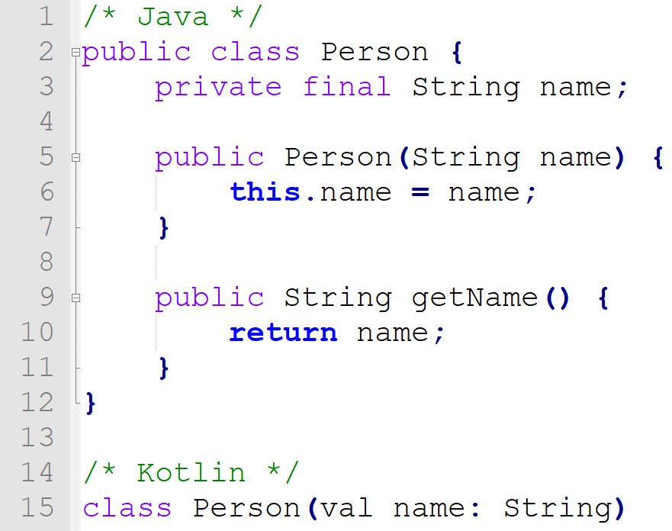
Sebesta language evaluation
Simplicity - Declaration

Slide 13
Sebesta language evaluation
Type checking
Kotlin’s ‘smart cast’ = type cast
Exception handling
Same as in Java Try/Catch

Slide 14
Summary
Goals: Modern, concise, pragmatic, and focused on interoperability with Java code
Used in well known Android applications
Hybrid: functional, OO, imperative, declarative, procedural
Null-safety, smart cast, etc
Simple, reliable and safe

